Slide 1
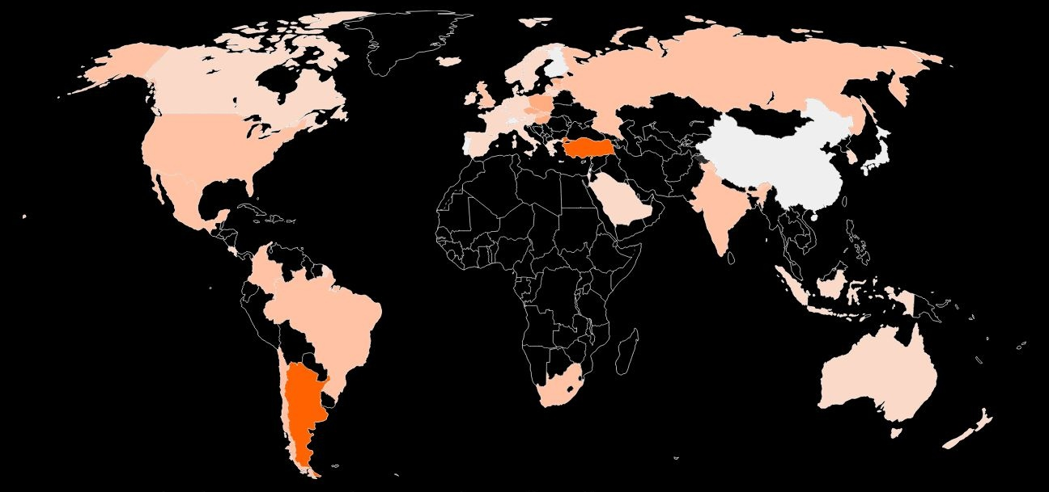
Exploring the sentiment on inflation and its impact on the economy through Twitter analysis
Deeksha Shetty

Slide 2






AGENDA
Introduction
Objectives & Motivation
Workflow
Results and Insights
Model comparison
Summary and Challenges

Slide 3
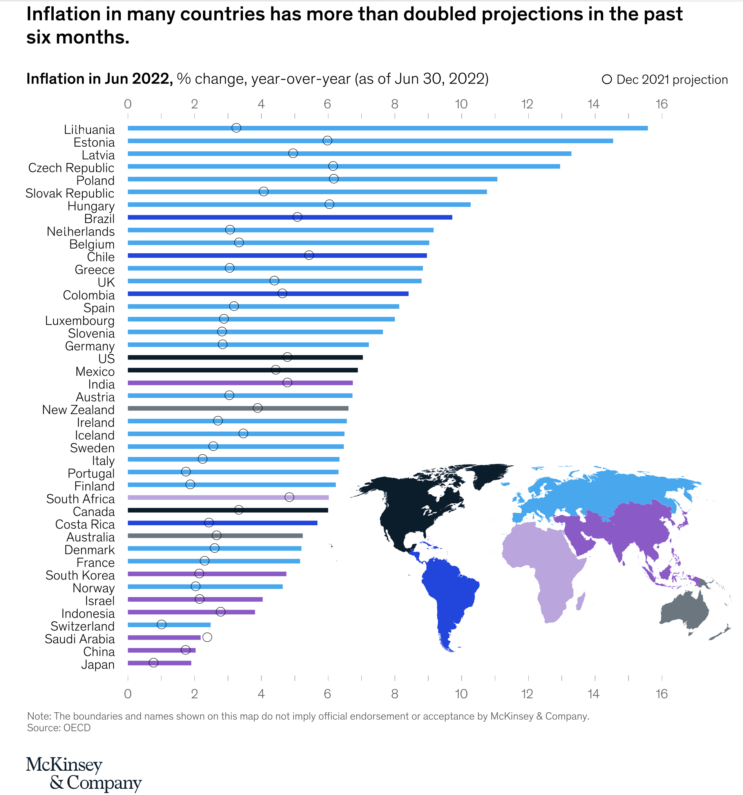
Introduction
Double Trouble: growing economic concerns
Actual rates have doubled projections
Inflation rates in:
Canada = 6.80 %
United States of America = 8.3%
Poland = 11%
United Kingdom =9%
India = 7%
China and Japan, inflation remains muted.
Gauge public sentiment on the efforts to curb inflations and its impact on global economy.
Picture source : McKinsey & Company

Slide 4
AGENDA
Introduction
Objectives & Motivation
Workflow
Results and Insights
Model comparison
Summary and Challenges

Slide 5
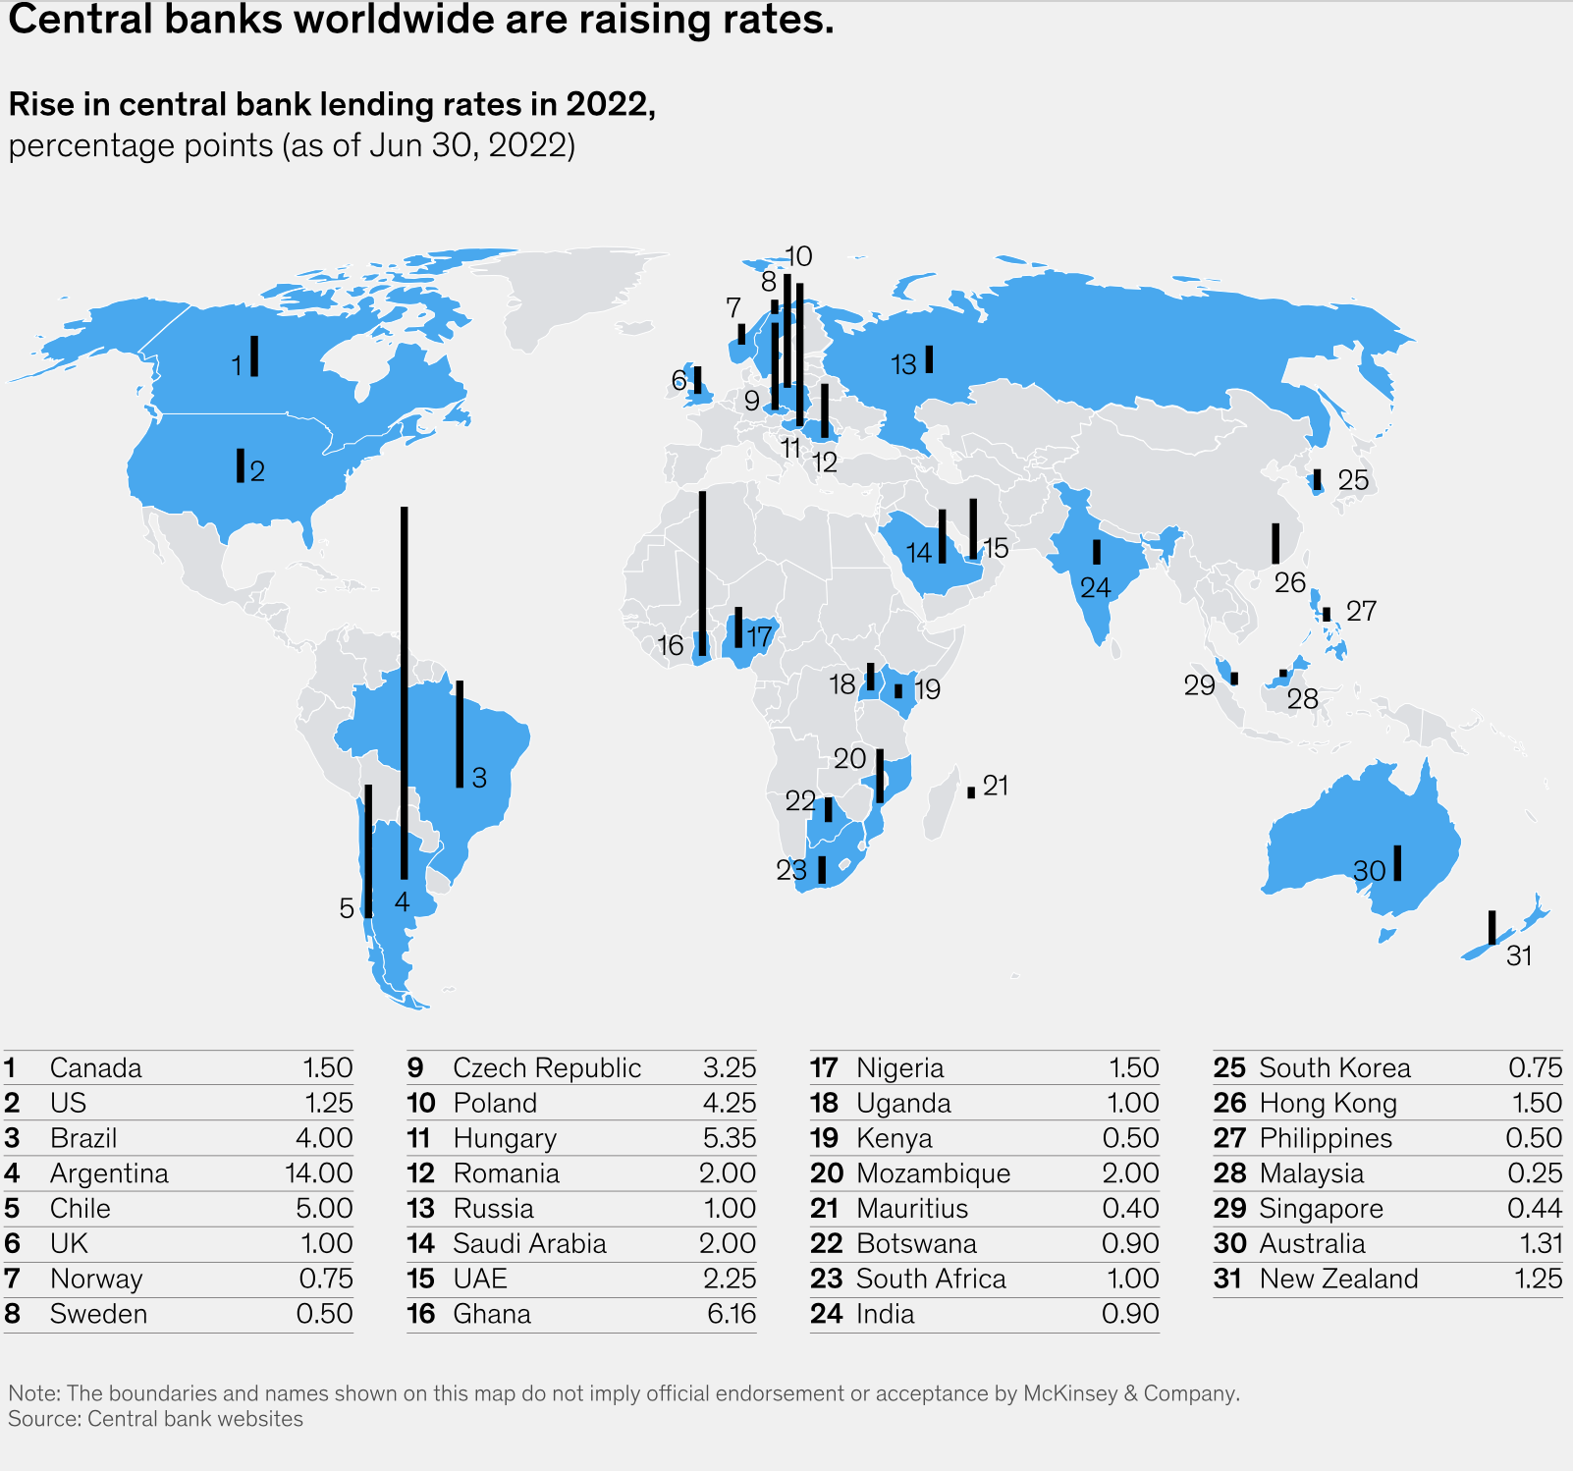
Objective 1: To analyze the sentiments of people worldwide on increasing interest rate to curb inflation

Slide 6
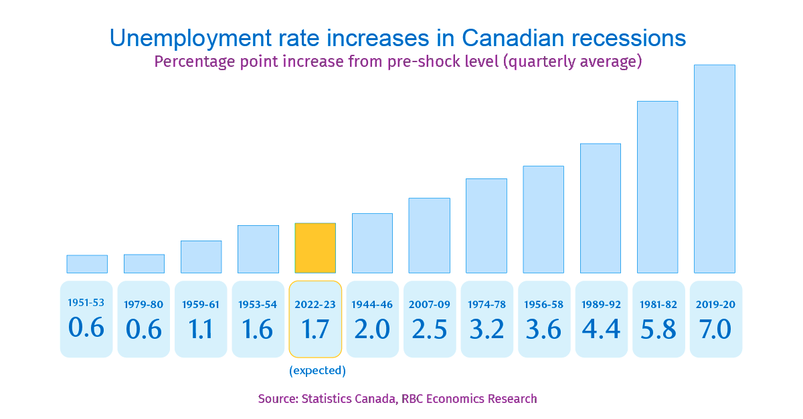
Objective 2: Examining the relationship between inflation and employment, and analyzing Canadian public sentiment

Slide 7
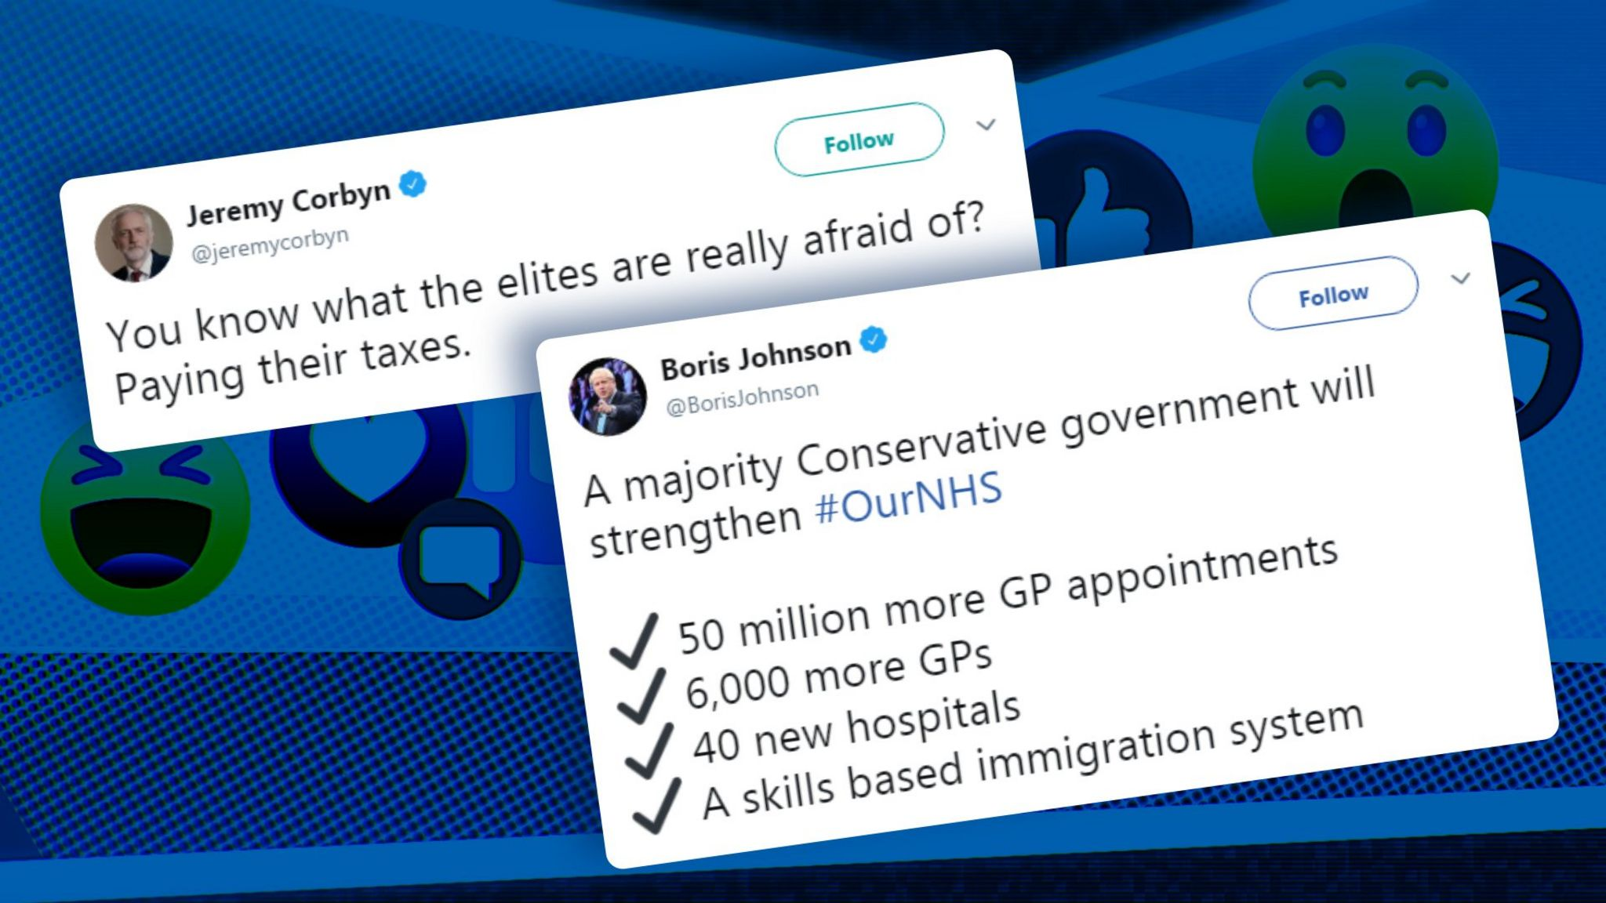
Objective 3: To explore how the sentiment of tweets about inflation varies based on the political stance of the tweeters , and to identify any potential factors that may contribute to these differences.

Slide 8
AGENDA
Introduction
Objectives & Motivation
Workflow
Results and Insights
Model comparison
Summary and Challenges

Slide 9
WORKFLOW & CHALLENGES
Raw tweets on Inflation [13th Dec- 16th Dec]
889928 datapoints
Select data only after 14th Dec
167543 data points
Preprocessing
Remove duplicates, null values,
@ symbols & URLs, stop words, tokenize, Count Vectorize, IDF
Classify into positive, negative and neutral tweets using Vader Sentiment Analysis
Sentiment Analysis
Train-Test split
117213 train and 50330 test
Predictions
Logistic regression, SVM and Random forest

Slide 10
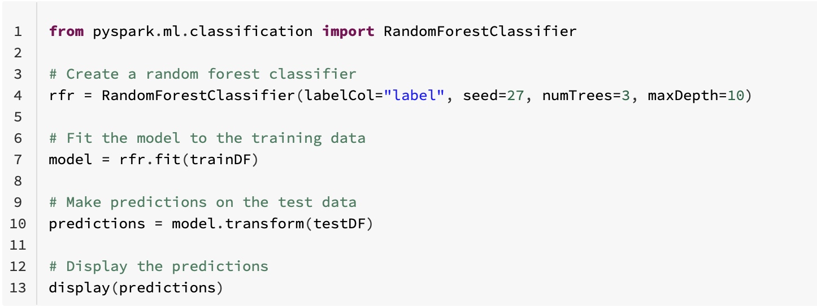
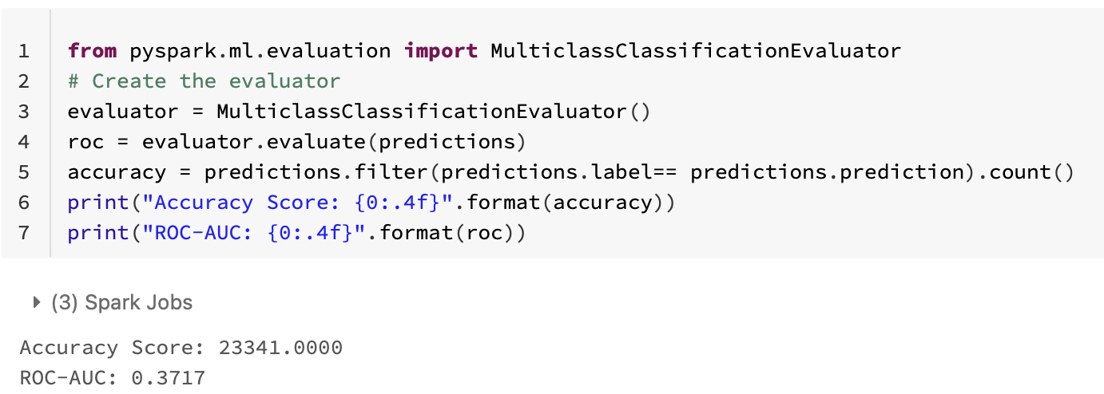
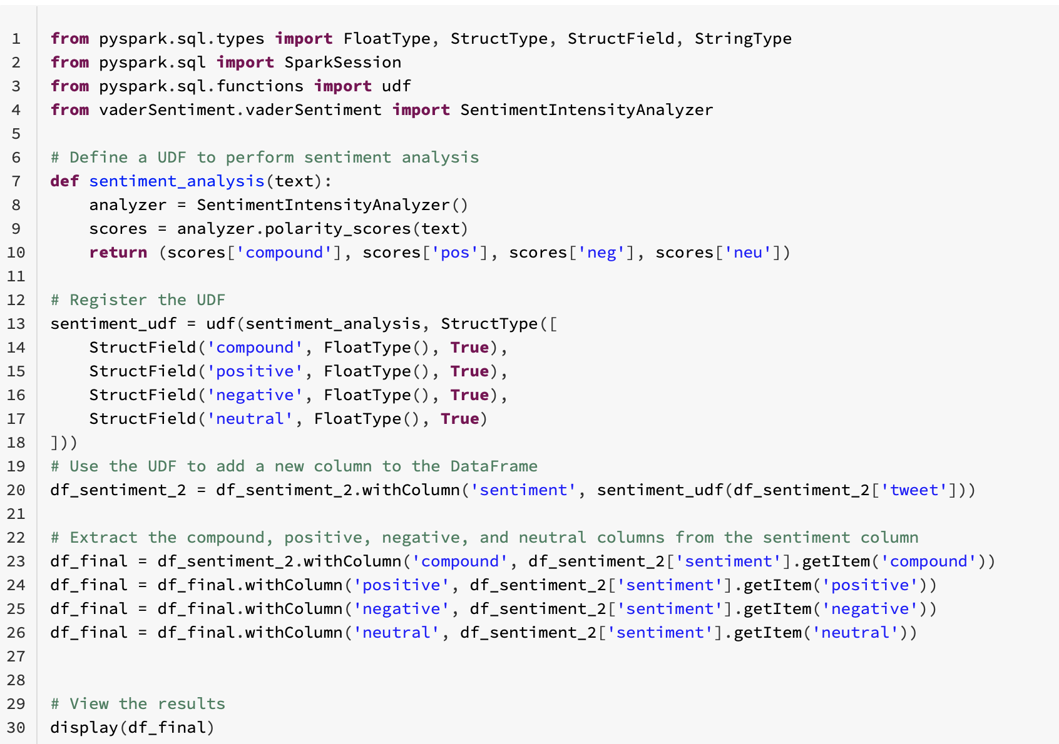
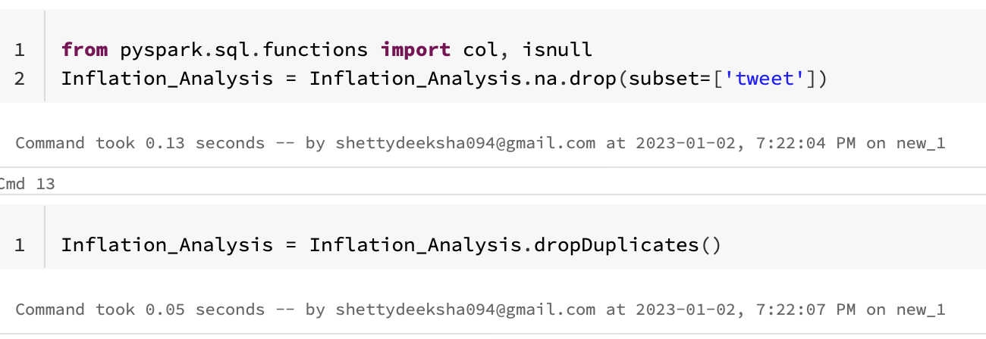
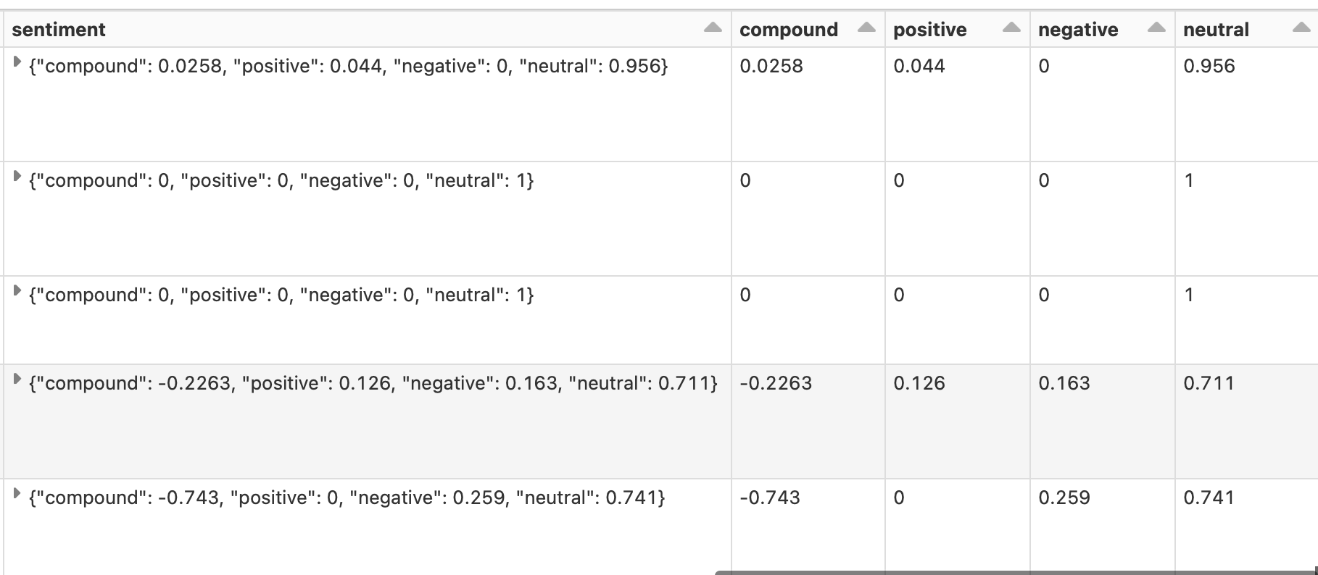
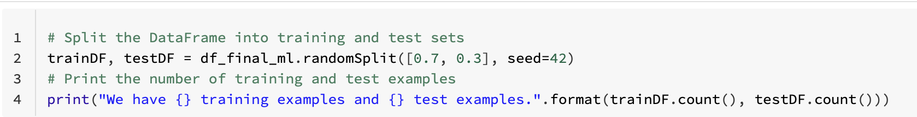

Slide 11
AGENDA
Introduction
Objectives & Motivation
Workflow and Challenges
Results and Insights
Model comparison
Summary & Challenges

Slide 12
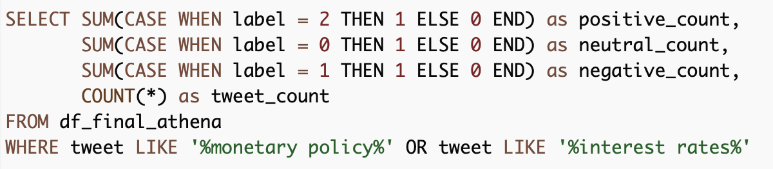
Objective 1: To analyze the sentiments of people worldwide on increasing interest rate to curb inflation

Slide 13
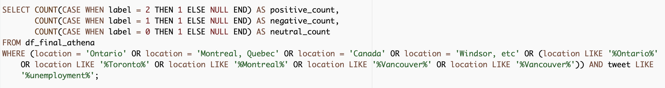
Objective 2: Examining the relationship between inflation and employment, and analyzing Canadian public sentiment

Slide 14
Objective 3: To explore how the sentiment of tweets about inflation varies based on the political stance of the tweeters , and to identify any potential factors that may contribute to these differences.
Step 1 : Write a query to identify the users who have tweeted the most on the date the tweets were collected."
"A subset of users was selected for analysis based on their follower count and their activity on a specific day. The sample was further restricted to individuals located in the United States."
Step 2: Construct a query that retrieves the username, number of tweets, and sentiment labels for a specified subset of users using Vader sentiment analysis."
Step 3: Determine the number of negative, positive, and neutral tweets for each user and associate them with the user's political leanings as indicated by their Twitter handle."

Slide 15


11 negative tweets, 18 positive tweets and 7 neutral tweets
24 negative tweets

Slide 16

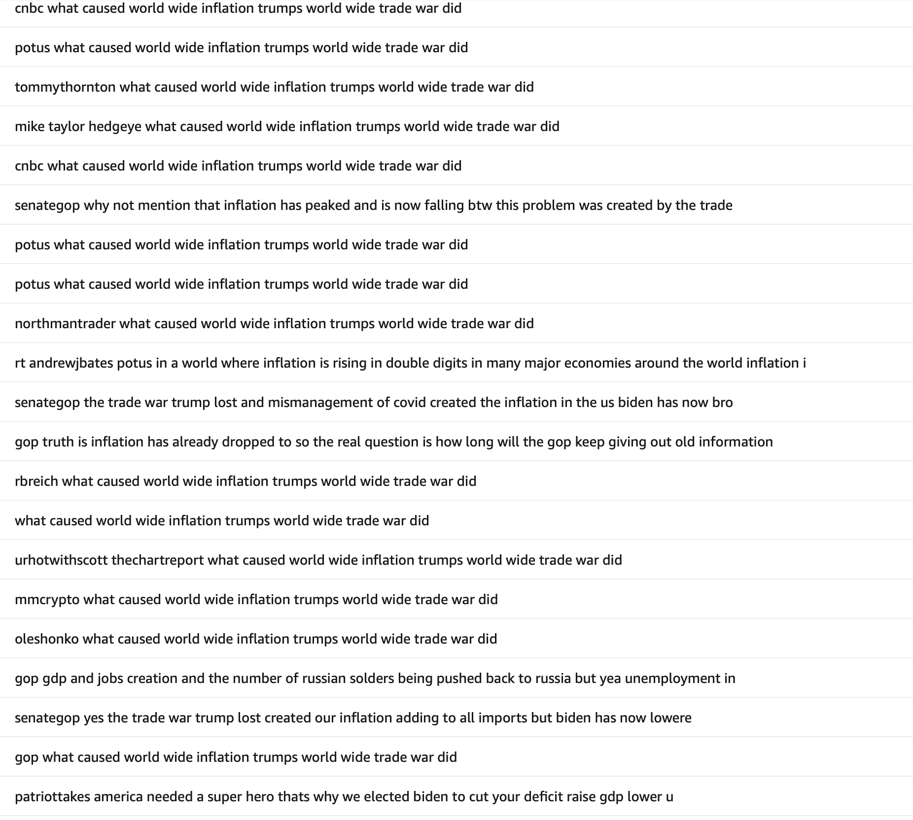
20 negative tweets, 2 positive tweets and 1 neutral tweet

Slide 17
AGENDA
Introduction
Objectives & Motivation
Workflow and Challenges
Results and Insights
Model comparison
Summary & Challenges

Slide 18
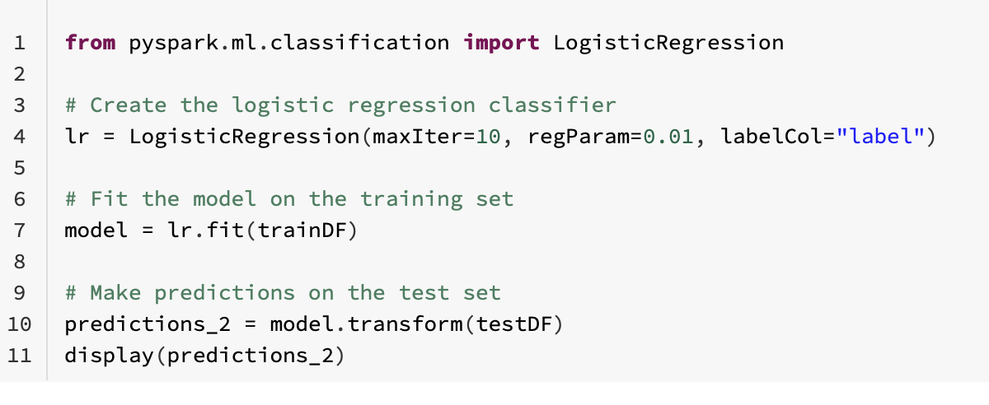
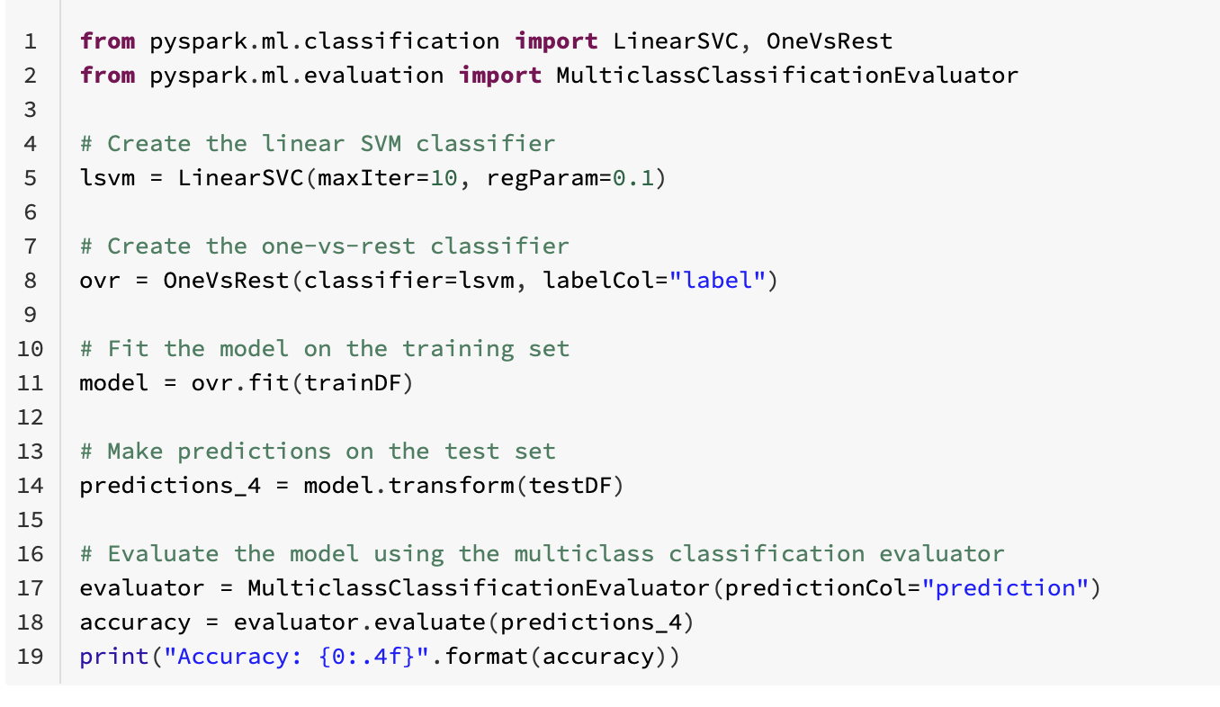
Model Comparison
 | Random forest | Logistic regression | Support vector machine
ROC-AUC | 37% | 92.7% | 91.17%

Slide 19
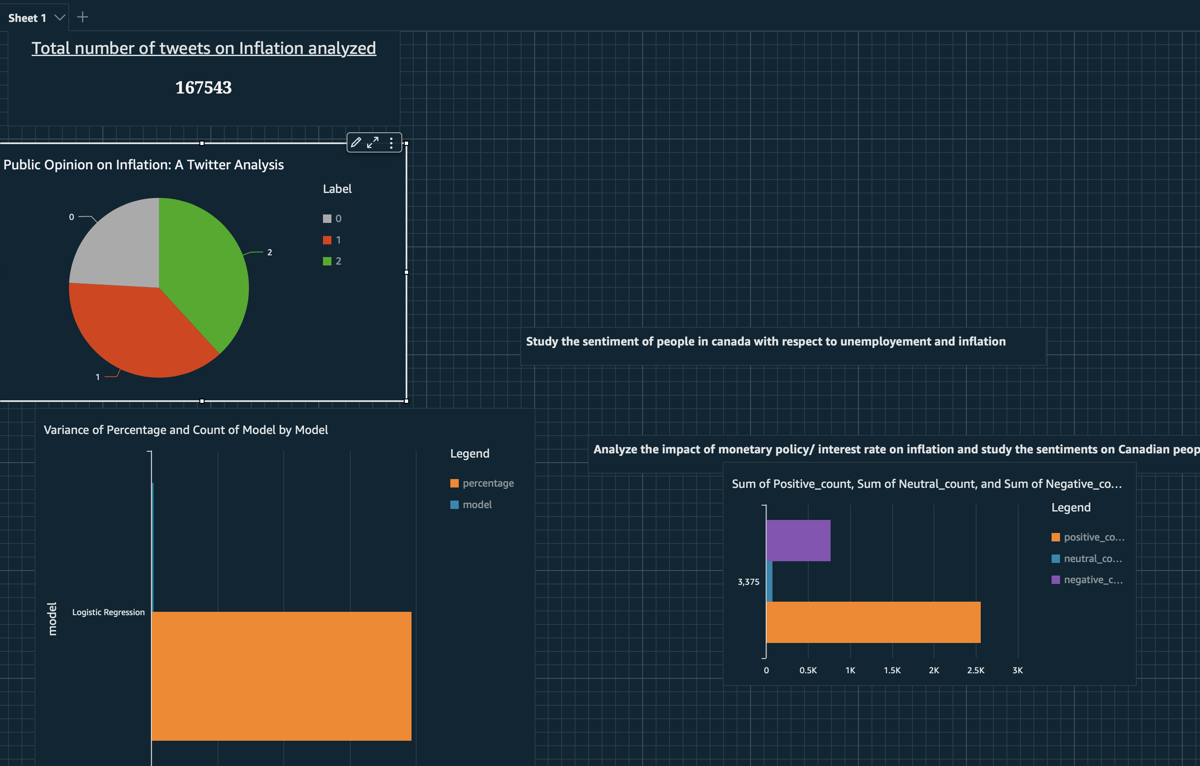

Slide 20
AGENDA
Introduction
Objectives & Motivation
Workflow and Challenges
Results and Insights
Model comparison
Summary & Challenges

Slide 21
SUMMARY & CHALLENGES
In this Twitter sentiment analysis project, I examined people's opinions on Interest rates and Unemployment.
The results showed that unemployment had a mostly negative sentiment, while interest rates had a positive sentiment.
I also found that political stance appeared to have an influence on people's opinions on these topics. However, more work needs to be done in that respect.
In terms of modeling, logistic regression performed the best among the different ML models compared.”
This project presented a number of challenges, including:
Sluggish performance on my laptop due to the large volume of data
Difficulty executing commands and maintaining a stable cluster
Struggles importing specific datatype columns into Athena.
Challenges building the pipeline
A learning curve in using QuickSight for the first time
Overall, there were several technical obstacles that had to be overcome in order to complete this project."

Slide 22
Thank you !!!

